Slide 1

BUS7C2
Finance and
Accounting for
Business
Tutorial 2 – Practice Questions & Solutions : 1 & 2

Slide 2
General Slide Option 1
Practice Questions 1 Solutions

Slide 3
Which of the following accounting concept states that sales should be recognized when goods or services are passed on to the buyer, and costs should be recognized when goods or services have been received?
Business entity concept
Materiality concept
Duality concept
Accruals concept

Slide 4
d) Accruals concept
“accrual accounting depicts the effects of transactions and other events and circumstances on a reporting entity’s economic resources and claims in the periods in which those effects occur, even if the resulting cash receipts and payments occur in a different period”……(IASB 2018)
An alternative to the accrual basis is the cash basis.
Under cash-basis accounting, companies record revenue and expense at the time they receive or pay out cash.
Notes:
Accrual-basis accounting is required by generally accepted accounting principles (GAAP).
Individuals and some small companies, however, do use cash-basis accounting.
The cash basis is justified for small businesses because they often have few receivables and payables. Medium and large companies use accrual-basis accounting.

Slide 5
2. Which of the following statements about accounting concepts are correct?
The money measurement concept is that only items capable of being measured in monetary terms can be recognised in financial statements.
The going concern concept is the assumption that an entity will continue in operational existence at least for an accounting year.
The matching concept refers to the assumption that in the measurement of profit, costs should be set against the revenue that they generate at the time when this arises.
The substance over form convention is that, whenever legally possible, the economic substance of a transaction should be reflected in financial statements rather than simply its legal form.
1,2 and 3
1,2 and 4
1,3 and 4
2,3 and 4

Slide 6
2. Which of the following statements about accounting concepts are correct?
The money measurement concept is that only items capable of being measured in monetary terms can be recognised in financial statements.
The going concern concept is the assumption that an entity will continue in operational existence at least for an accounting year.
The matching concept refers to the assumption that in the measurement of profit, costs should be set against the revenue that they generate at the time when this arises.
The substance over form convention is that, whenever legally possible, the economic substance of a transaction should be reflected in financial statements rather than simply its legal form.
1,2 and 3
1,2 and 4
1,3 and 4
2,3 and 4

Slide 7
Which accounting concept should be considered if the owner of a business takes goods from inventory for his own personal use?
The Prudence concept
The separate entity concept
The duality concept
The money measurement concept

Slide 8
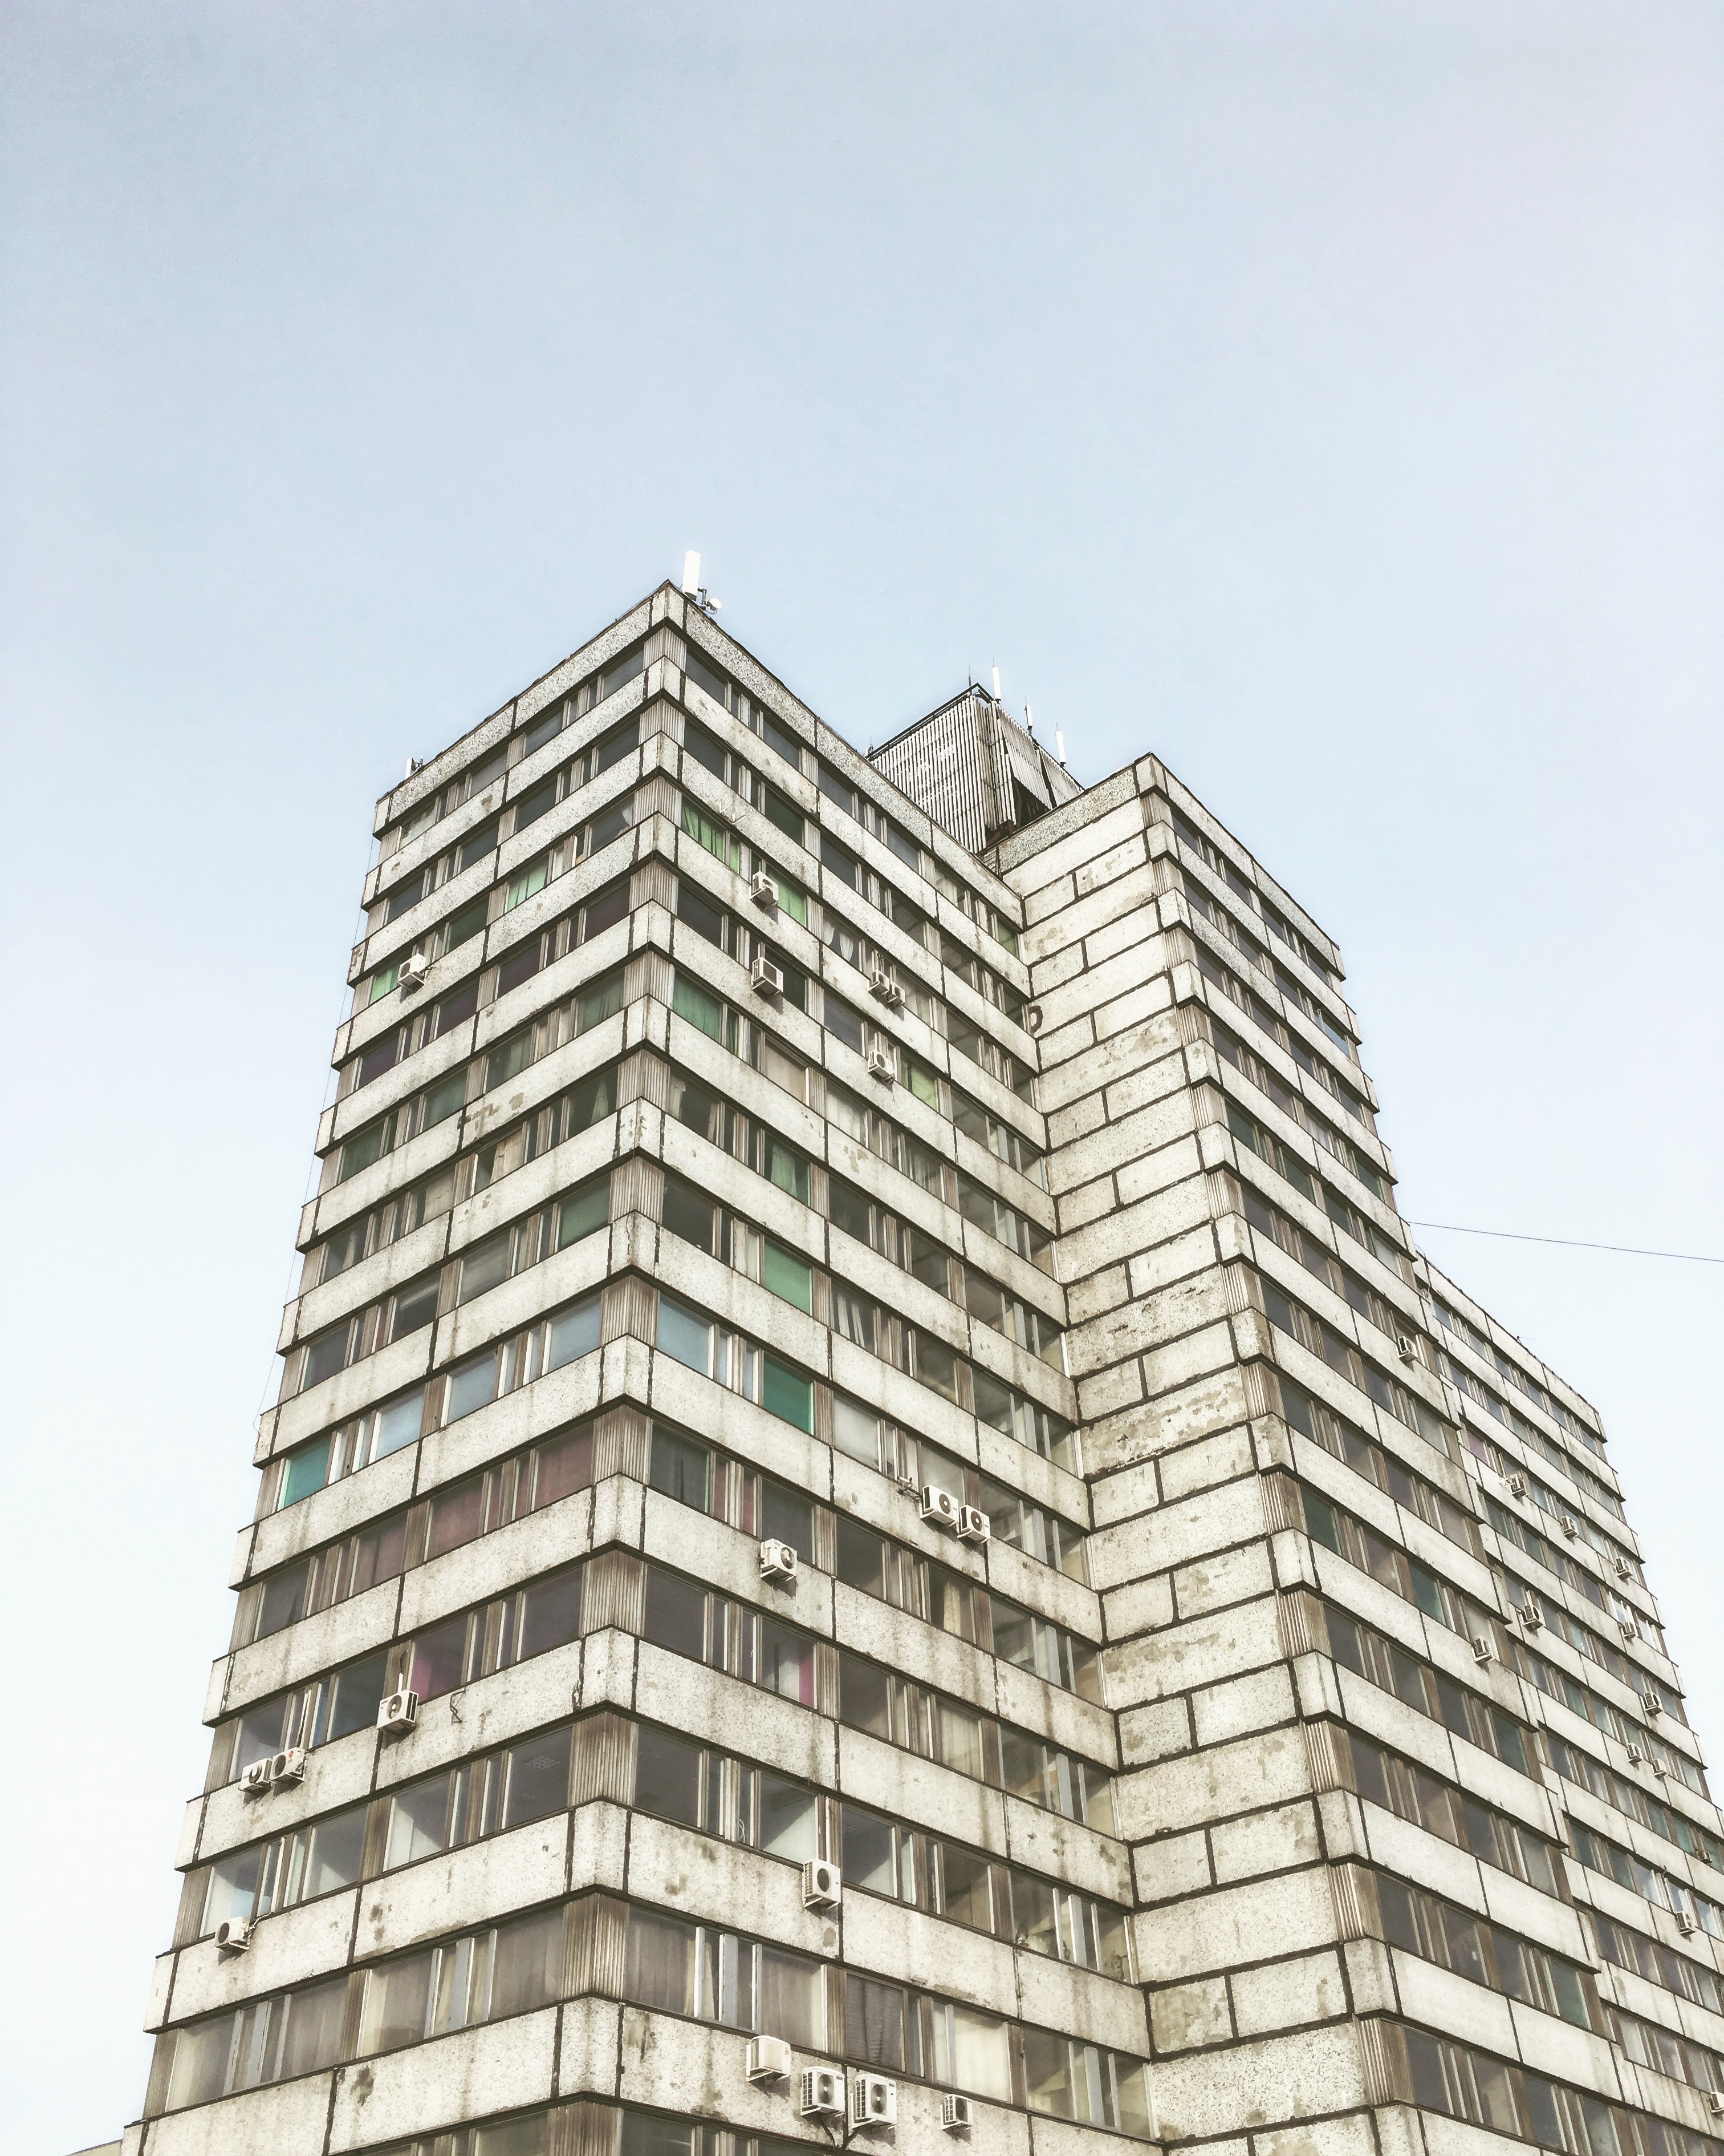

b) The separate entity concept
Separate
Business
Business Owner
This principle requires that business transactions are to be keep separately from the owner’s
personal transactions. Even when it’s a transaction between the owner and the business
This Photo by Unknown Author is licensed under CC BY-NC
Notes:
The major transactions between a business and its owners are recorded in the Capital Drawings accounts.

Slide 9
Sara is a sole trader and had assets of £260,500 and liabilities of £124,800 on 1 January 2018. During the year ended 31 December 2018 she paid £35,000 capital into the business and withdrew £10,000 for personal purposes. At 31 December 2018, Sara had assets of £302,300 and liabilities of £102,700.What is Sara’s profit for the year ended 31 December 2018?
£63,900
£38,900
£88,900
£99,600

Slide 10
b) £38,900
Capital & Drawings Transactions 1 Jan to 31 Dec Capital Addition +£35,000 Drawings -£10,000 Net Position +£25,000
Profit/(Loss) Difference +£38,900
Opening Balance 1 Jan 2018 Asset +£260,500 Liability -£124,800 Net Position +£135,700
Closing Balance 31 Dec 2018 Asset +£302,300 Liability -£102,700 Net Position +£199,600

Slide 11
A company receives rent from a large number of properties. The total received in the year ended 31 March 2021 was £240,100. The following were the amounts of rent in advance and in arrears at 31 March 2020 and 2021:
31 March 2020 31 March 2021
Rent received in advance 14,700 15,200
Rent in arrears (all received later) 10,100 9,700
What amount of rental income should appear in the company’s statement of profit or loss for the year ended 31 March 2021?
£239,200
£240,000
£241,000
£240,200

Slide 12
£239,200
 | Action | 2021 P&L £ | Remarks
Rent receieved in 2021 |  | 240,100 | The P&L is prepared on an accrual basis, not a cash basis
Rent received in advance (2020) | Add (+) | 14,700 | Cash was received in 2020, but this rent is for 2021 so it will be recorded as revenue in 2021 P&L
Rent in arrears (2020) (received in 2021) | Subtract (-) | -10,100 | Though cash was received ij the current year (2021), it is for a transaction that occurred in 2020, so it was already recorded in 2020 P&L and cannot be recorded again in this year's (2021) P&L
Rent received in advance (2021) | Subtract (-) | -15,200 | This is payment in advance for next year (2022), so it cannot be recorded in this year's (2021) P&L
Rent in arrears (2021) (received in 2022) | Add (+) | 9,700 | This is current year (2021) rent that is due. Though it has not been paid, it is a 2021 transaction, so it will be recorded in 2021 P&L
Rent recorded in 2021 P&L |  | 239,200 | This is the amount that will be recorded as “rent revenue” for 2021 in the Statement of Profit & Loss

Slide 13
A business finalizes its financial statements on 31st of March every year and the rent are paid quarterly on 1st Feb, 1st May, 1st August and 1st November each year. The rent increased to £39,000 from £36,000 with effect from 1st February this year. What amount should be recorded as rent expenses for the year ending 31st March of the current year?
£36,750
£36,500
£37,250
£37,500

Slide 14
b) £36,500
Financial Year 1st April - 31st March
Q1 |  |  | Q2 |  |  | Q3 |  |  | Q4 |  |  | Rent Expense for the Year
Apr | May | Jun | Jul | Aug | Sep | Oct | Nov | Dec | Jan | Feb | Mar
£36,000 p.a |  |  |  |  |  |  |  |  |  | £39,000 p.a
£3,000 | £3,000 | £3,000 | £3,000 | £3,000 | £3,000 | £3,000 | £3,000 | £3,000 | £3,000 | £3,250 | £3,250 | £36,500

Slide 15
XYZ Ltd. took a bank loan of £6,000 for business development purposes. The interest for the year amounted to £250 and repayment of loan during the year was £1,000. Which among the following is the amount of bank loan to be shown in the statement of financial position at the end of the year?
£6,250
£4,750
£5,250
£6,750

Slide 16
C) £5,250
 | Action | SFP £
Loan (original Amount) |  | 6,000
Repayment for the year | Subtract (-) | -1,000
Interest for the year | Add (+) | 250
Loan Balance (SFP) |  | 5,250

Slide 17
General Slide Option 1
Practice Questions 2 Solutions

Slide 18
Shannon started her new business on Dec 1 and the following transactions are related to the month of December:
1 Dec Introduced a delivery van to the new business worth £16,000
2 Dec Took a laptop from home to the business: £1,500
3 Dec Withdrew £400 cash from business account to pay personal credit card debt.
4 Dec Transferred £20,000 to the business bank account from her personal account to cover business start-up costs
Which among the following should be included in the statement of financial position as Owner’s capital account balance?
£37,100
£37,500
£37,900
£34,900

Slide 19
A) £37,100 Remember the Separate Entity Concept/Principle!!!
S/N | Transaction | Owners Capital? Y/N | Amount £ | COMMENT
1 | Introduced a delivery van to the new business worth £16,000 | Y | 16,000 | Owner introduced personal assets (van and laptop) into the business
2 | Took a laptop from home to the business: £1,500 | Y | 1,500
3 | Withdrew £400 cash from business account to pay personal credit card debt. | Y | -400 | This is called "Drawings" in accounting i.e. when an owner utilises business asset (in this case cash) for personal, non-business use.
4 | Transferred £20,000 to the business bank account from her personal account to cover business start-up costs | Y | 20,000 | Owner introduced personal assets (van) into the business
 | Owner's Capital (SFP) |  | 37,100

Slide 20
Chalk purchases £500 worth of cheese from Cheddar Co. Chalk agrees to pay Cheddar Co in 30 days' time. What is the double entry to record the purchase in Cheddar Co's books?
Debit sales £500, credit receivables £500
Debit purchases £500, credit payables £500
Debit receivables £500, credit sales £500
Debit payables £500, credit purchases £500

Slide 21
c) Debit Receivables £500, credit Sales £500
Cheddar is the seller and Chalk the buyer
This is a “Credit Sale” to Cheddar; and a “Credit Purchase” to Chalk
The “receivable” account is sometimes called “trade debtors” account
If Chalk had paid immediately for the cheese, the double entry would be……….. Debit bank/cash £500; credit Sales £500

Slide 22
Which ONE of the following statements is true?
A debit records an increase in liabilities
A debit records a decrease in assets
A credit records an increase in liabilities
A credit records an increase in equity

Slide 23
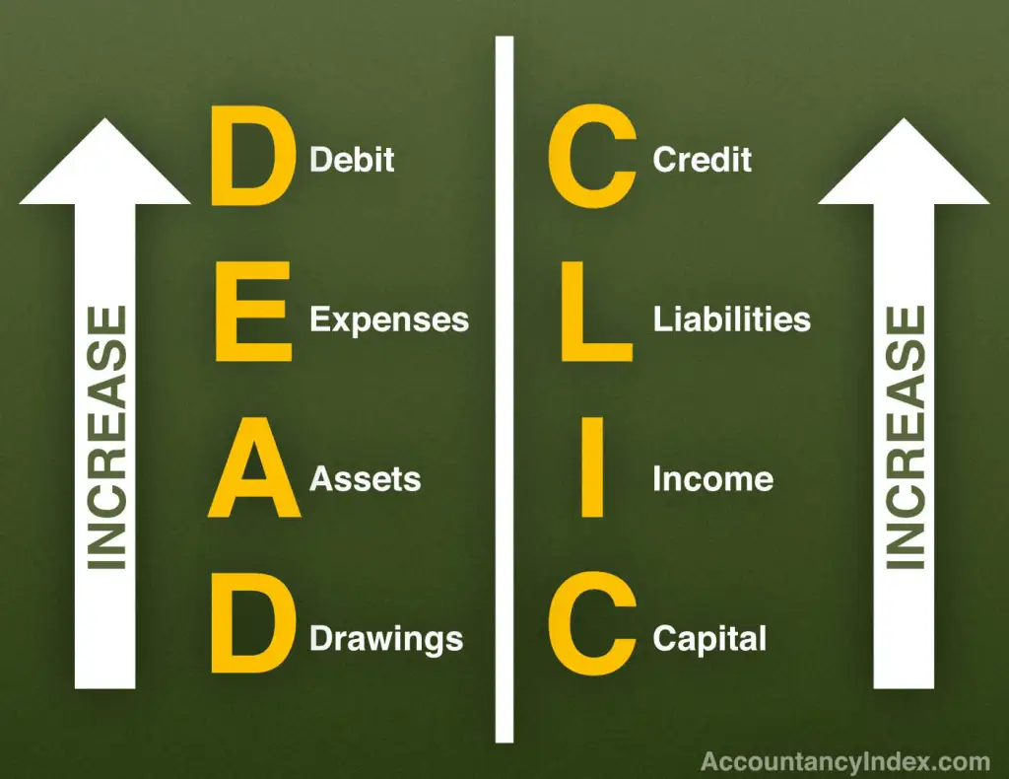
c) A credit records an increase in liabilities
Use the acronym DEAD CLIC to remember

Slide 24
The following transactions were omitted from the books of accounts due to accountant’s error.
1. Purchase of goods for cash worth £300
2. Purchase of equipment worth £1,000
3. Payment of electricity expenses £250.
Which of the above transactions would affect the profit already computed?
All three
Only 1 and 3
Only 1 and 2
None

Slide 25
b) Only 1 and 3
S/N | Transaction | Profit Affected? Y/N | Amount £ | COMMENT
1 | Purchase of goods for cash worth £300 | Y | 300 | ~Only income and expenses (includes sales & purchases) are recorded in the SPL for computing profits or losses ~Assets (includes equipment), drawings, capital and liabilities are recorded in the SFP. They are not used to calculate profit or loss
2 | Purchase of equipment worth £1,000 | N | 1,000
3 | Payment of electricity expenses £250 | Y | 250

Slide 26
What amount should be recorded as expense related to wages in the statement of profit or loss if wages paid are £3,000 and accrued wages at the end of the year was £500?
£2,500
£3,500
£3,000
£4,000

Slide 27
b) £3,500
Expense for the Year (e.g. Wages……same for all expenses)
=
Actual cash/bank payment
+
Accrued wages (due but not yet paid)
-
Prepaid wages (paid but not yet due)

Slide 28
Roger has discounts allowed of £600 in his trial balance. How should this amount be reported in his financial statements?
£600 CR to purchases
£600 DR to purchases
£600 DR to expenses
£600 DR to other income

Slide 29
c) £600 DR to expenses
Discount allowed is a reduction in the price of goods or services allowed by a seller to a buyer
It is an expense for the seller.
Expenses are “debits” to the SPL

Slide 30
A business has compiled the following information for the year ended 31 October 2020: £
Opening inventories 200,000
Purchases 650,000
Closing inventories 325,000
The gross profit percentage of sales is 40%. What is the sales revenue for the year?
£325,000
£875,000
£525,000
The sales revenue is impossible to calculate from this information

Slide 31
b) £875,000

Slide 32

Thank you, very much!
Any questions?

